Slide 1
Achieving a Photon and Neutron community federated cloud in EOSC
2nd November 2020
Enabling our facilities to produce FAIR data
Brian Matthews,
UKRI-STFC

Slide 2
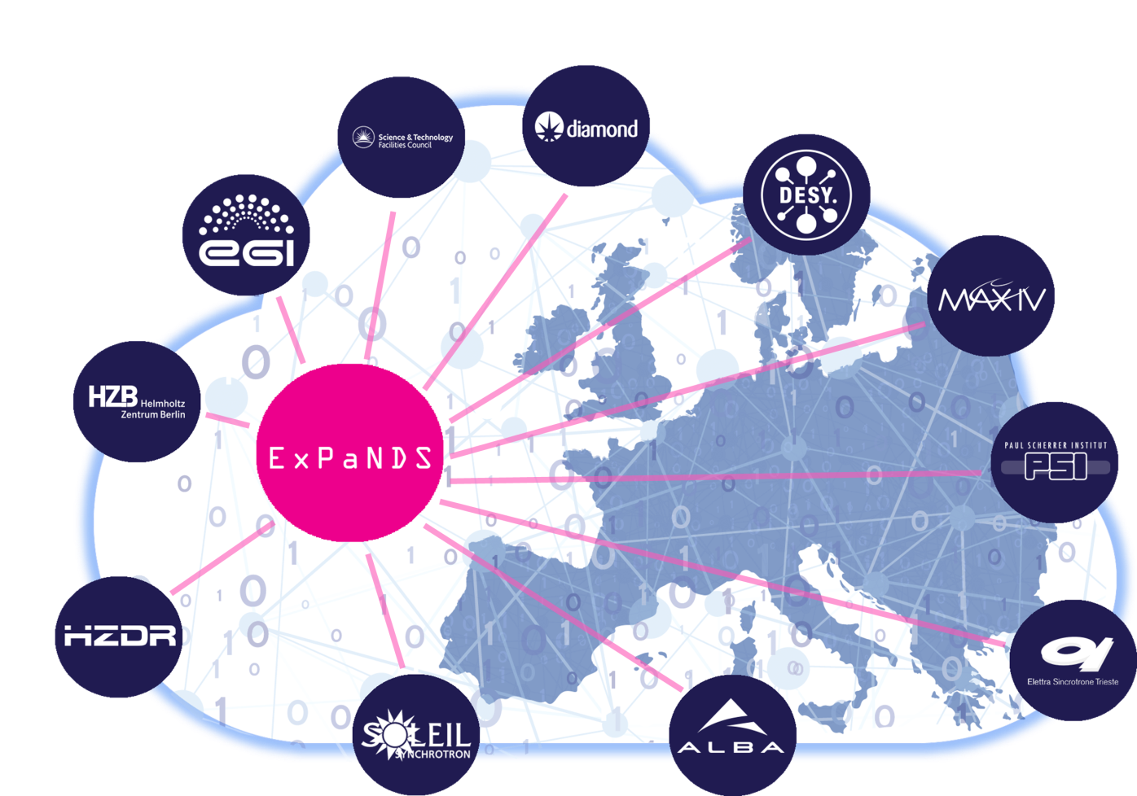

ExPaNDS WP2: Enabling FAIR data PaNOSC WP2: Data Policy and Stewardship
Review and recommend the policies, practises, standards and tools which would develop best practise for FAIR data generation and use in the National Photon and Neutron RIs.
In the policies of the RIs
In the data-generation, collection and analysis process
In Data Management Planning
Raising awareness and competence in FAIR data of our scientific communities.
To guide services to support FAIRness

Slide 3
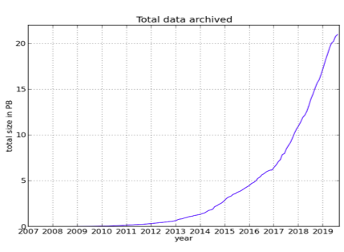



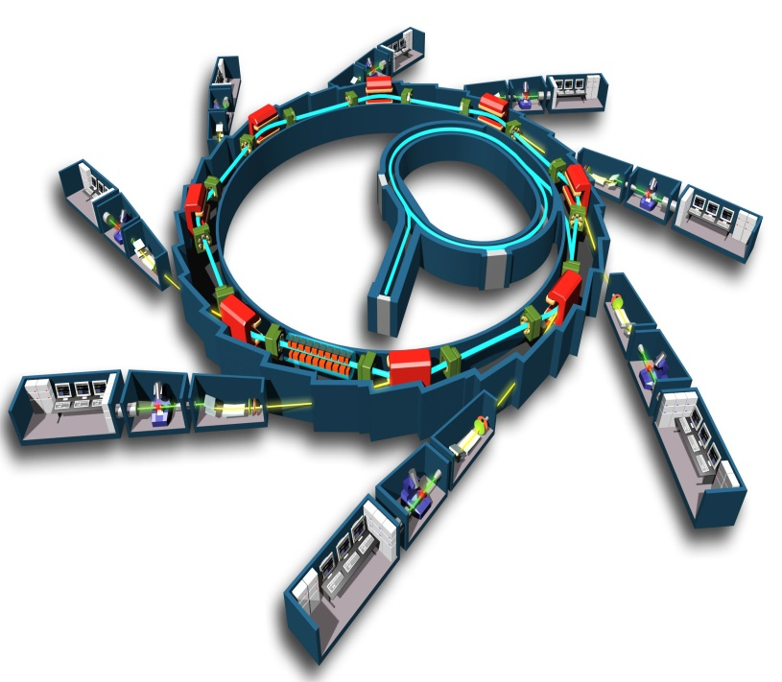

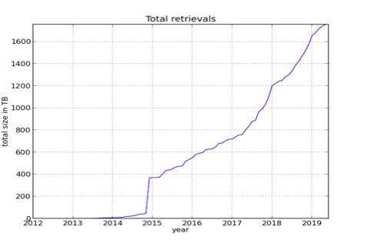



What’s the problem?
P&N experiments across disciplines
No single discipline approach
Data getting ever larger and more complex
Hard to move and handle
Hard to Process
Maximise the Science Value
Facilities are expensive!
P&N Facilities can support users to (re-)use data
Common data lifecycle
Common infrastructure
Daniel Salvat, Alba

Slide 4
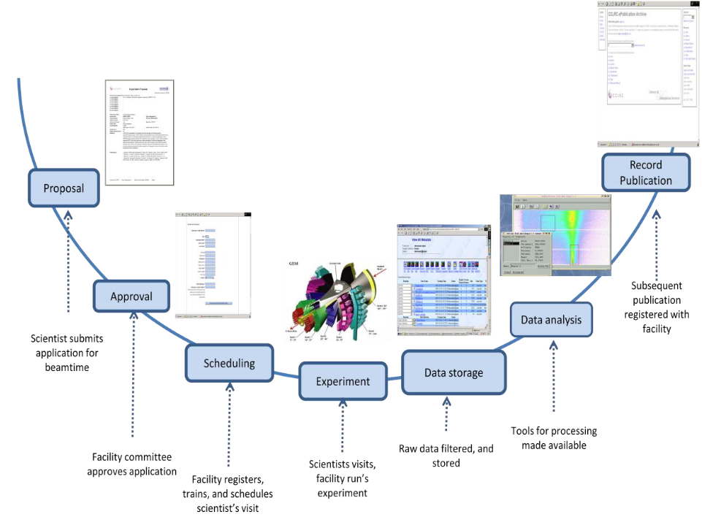
Facilities Lifecycle Overview
P&N Science is multi-discipline
P&N Facilities can support users to (re-)use data
Common infrastructure
Common data lifecycle
Make this FAIR!
Facilities have a good foundation
PaN-data Open Data Infrastructure. Model of the data continuum in Photon and Neutron Facilities. Deliverable 6.1, 2012 http://pan-data.eu/sites/pan-data.eu/files/PaNdataODI-D6.1.pdf
Notes:
HBR data lifecycle
https://hdsr.mitpress.mit.edu/pub/577rq08d/release/3

Slide 5
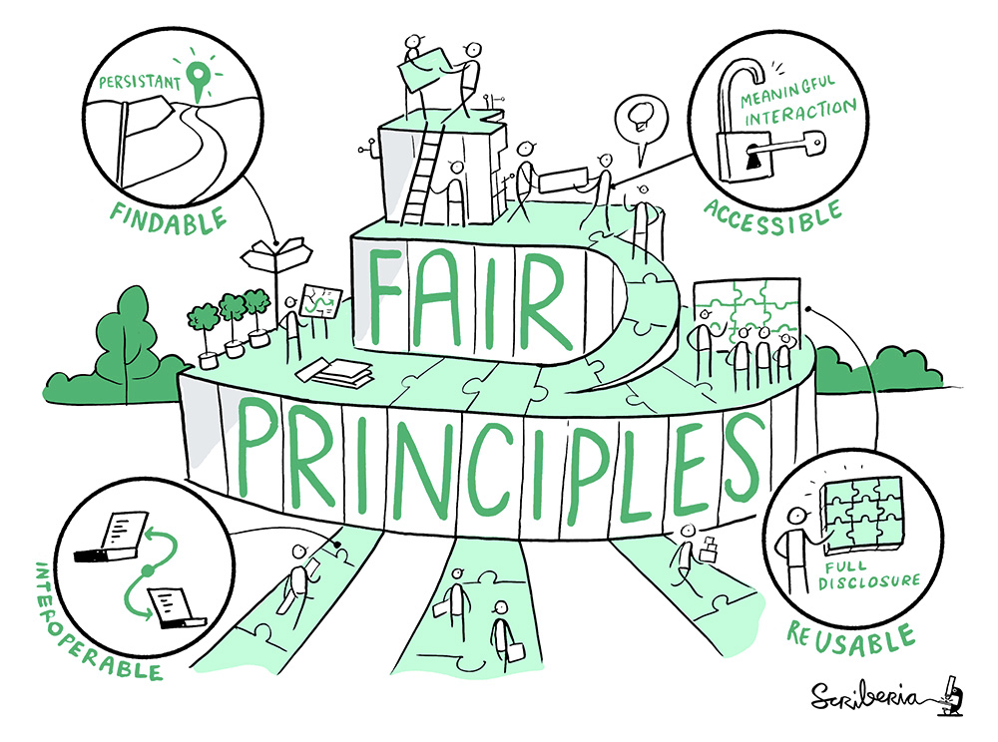
F1. (meta)data are assigned a globally unique and persistent identifier
F2. data are described with rich metadata (defined by R1 below)
F3. metadata clearly and explicitly include the identifier of the data it describes
F4. (meta)data are registered or indexed in a searchable resource
A1. (meta)data are retrievable by their identifier using a standardized communications protocol
A1.1 the protocol is open, free, and universally implementable
A1.2 the protocol allows for an authentication and authorization procedure, where necessary
A2. metadata are accessible, even when the data are no longer available
R1. meta(data) are richly described with a plurality of accurate and relevant attributes
R1.1. (meta)data are released with a clear and accessible data usage license
R1.2. (meta)data are associated with detailed provenance
R1.3. (meta)data meet domain-relevant community standards
I1. (meta)data use a formal, accessible, shared, and broadly applicable language for knowledge representation.
I2. (meta)data use vocabularies that follow FAIR principles
I3. (meta)data include qualified references to other (meta)data
The Turing Way Community, & Scriberia. (2020, March 3). Illustrations from the Turing Way book dashes. Zenodo. http://doi.org/10.5281/zenodo.3695300
Wilkinson, M., Dumontier, M., Aalbersberg, I. et al. The FAIR Guiding Principles for scientific data management and stewardship. Sci Data 3, 160018 (2016). https://doi.org/10.1038/sdata.2016.18

Slide 6
Steps towards FAIR Facilities
FAIR Policy
FAIR Guidelines
FAIR Tools
FAIR Experiments
Commitment to FAIR
Support from Facility to provide it
Ownership
Expectation on users
How FAIR can be supported along the data lifecycle
Use of PIDS
Metadata standards
Implementation strategies
Providing tools that support FAIR
Data storage
Data cataloguing and publishing
Data Analysis
Integrated VREs
ELNs
Support to conduct FAIR experiments
Planning for FAIR – DMPs
Facility staff and users
Embedding in processes

Slide 7
Data policy in P&N Facilities
Set some key principles
Open access to raw data and metadata
Curation of raw data supported by the facility
Data catalogue to make data accessible
Embargo periods for exclusive access to experimenters
Photon and Neutron RIs have a long track record on policy
PaN-data Europe common policy framework February 2011
Neutrons:
ILL- PanData data policy - 2012
ISIS-PanData data policy - 2012
Photons:
Elettra- PanData data policy - 2013
ESRF-PanData data policy - November 2015
MAXIV-PanData data policy - 2015
HZB-PanData data policy - June 2016
HZDR-PanData data policy - June 2016
PSI-PanData data policy - August 2016
EUXFEL-PanData data policy - August 2017
ALBA-PanData data policy - July 2017
DESY-PanData data policy - August 2017
SOLEIL PanData data policy - 2018
Diamond PanData data policy - March 2019
FELIX PanData data policy - 2019

Slide 8
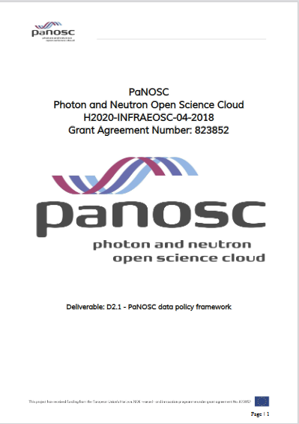
Towards FAIR policies for Photon and Neutron RIs
ExPaNDS and PaNOSC have been working together to revise data policies frameworks in the light the of FAIR data principles
PaNOSC D2.1: PaNOSC data policy framework
A model policy for adaptation and adoption by PaNOSC Partners
May 2020: https://doi.org/10.5281/zenodo.3826039
ExPaNDS D2.1: Draft Extended Data Policy Framework for
Photon and Neutron RIs
18th September 2020: https://doi.org/10.5281/zenodo.4014810
Guidance on adopting a FAIR data policy for national RIs
Taking into account FAIRsFAIR’s recommendations on Data Policy
Key Policy Elements within a PaN RI Data Policy Framework
30 data policy framework elements
Aim to have a common approach to data policy across
all P&N RIs
Value in a compatible approach in different facilities
Easier for users to move around, easier to combine data

Slide 9
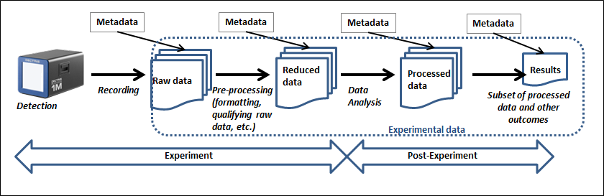
Adding FAIR to Policy
“RIs’ data policies should enable the experimental data in scope to be FAIR”
This gives an implicit commitment to uphold the FAIR principles.
Leads to other policy principles
RIs should specify the grounds for restricting access to data (A1.2)
In the event that data are deleted, the facility should retain a “digital footprint” of the data (A2)
The RI’s data policy should specify a licence under which the data are made available (R1.1)
The RI’s data policy should include commitments to enabling FAIR data which include [PIDs and Collecting sufficient Metadata]
And also requirements for implementations conforming to policy
Simplified illustration of Classes of Experimental Data in the Science Life Cycle (from the Soleil Data Policy)
“Data should be FAIR when it leaves the Facility”
Can be assessed via FAIR Metrics

Slide 10
FAIR Guidelines: FAIR at every step
PaN-data Open Data Infrastructure. Model of the data continuum in Photon and Neutron Facilities. Deliverable 6.1, 2012 http://pan-data.eu/sites/pan-data.eu/files/PaNdataODI-D6.1.pdf
Propose
Schedule
Experiment
Store
Analyse
Publish
Who
Instrument
Technique
What
Purpose
Funding
Prior research
Rights
Sample
Conditions
Setup
Simulations
Parameters
Values
Time
Experiment conditions
Instrument settings
Calibration
Location
Format
Size
Structure
Software
Parameters
Data inputs
Data outputs
Provenance
Results
Analysis
Citations
Provenance
User Office System
Experiment Planning
Instrument Control
Storage System
Analysis environment
Publication management
Collect, Connect, Curate
Notes:
HBR data lifecycle
https://hdsr.mitpress.mit.edu/pub/577rq08d/release/3

Slide 11
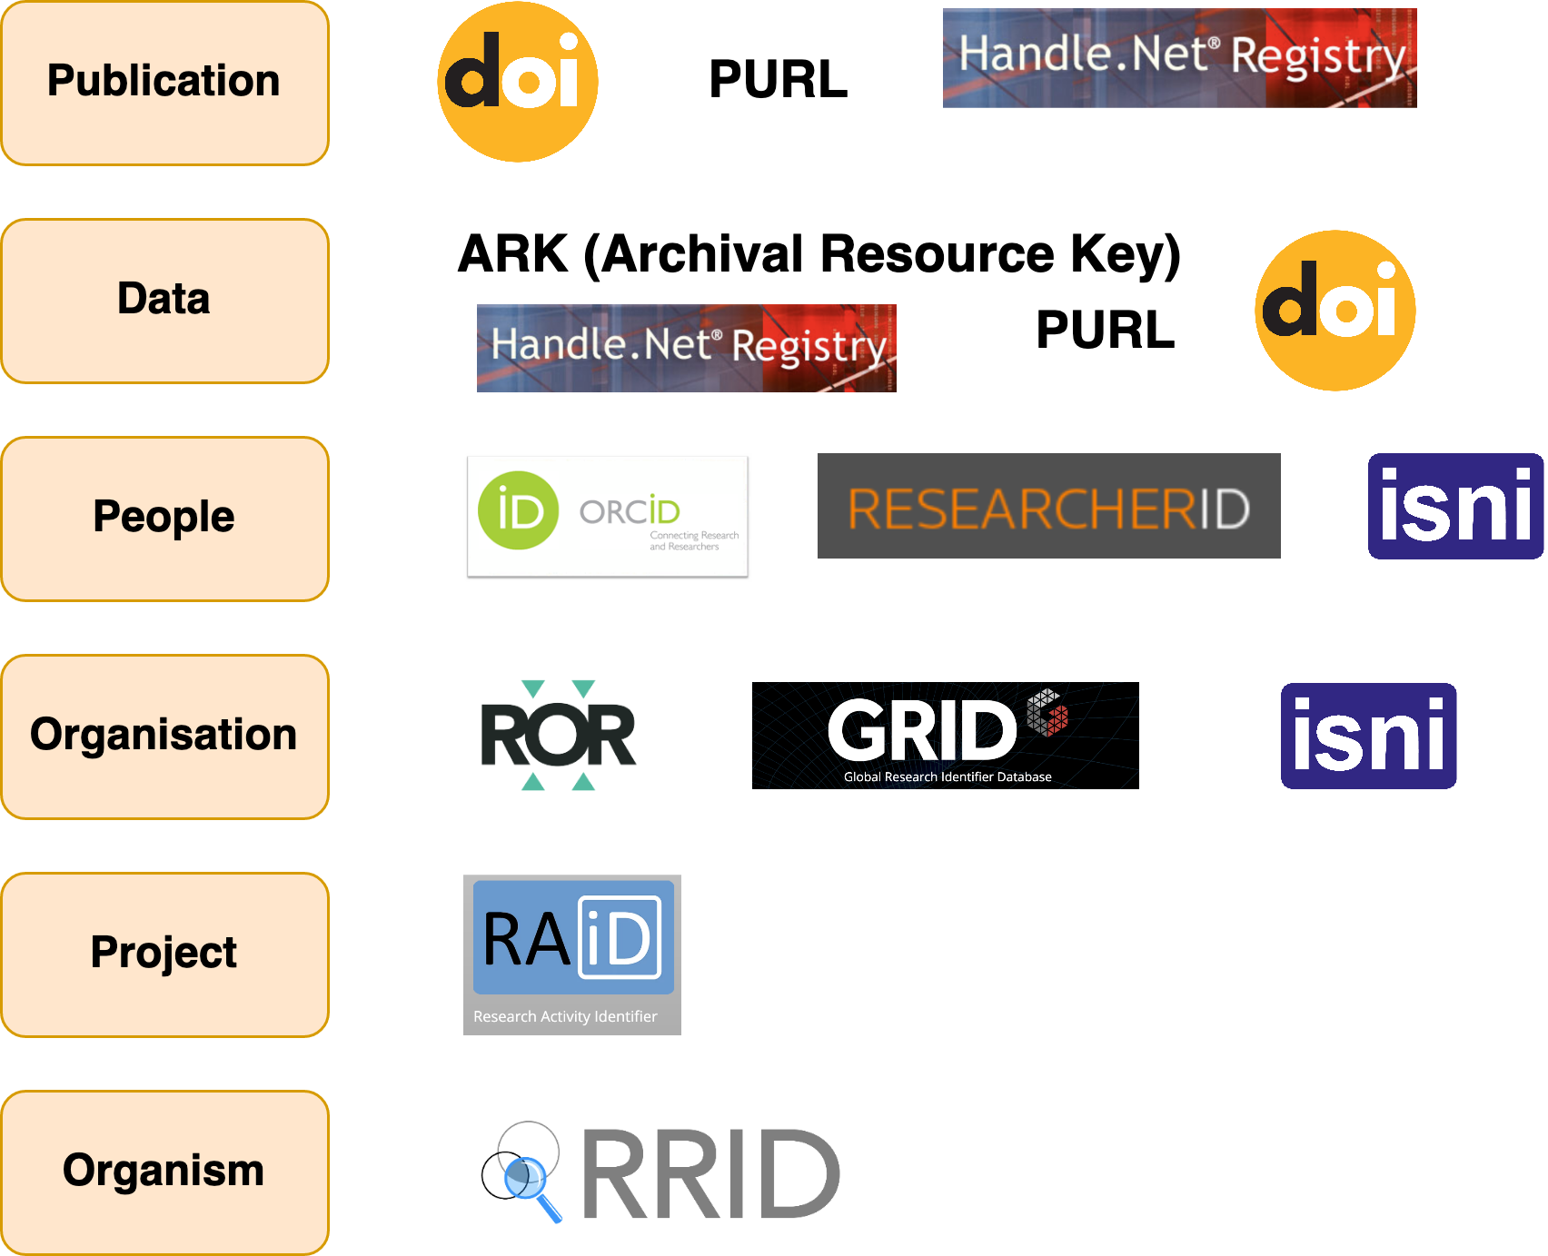





FAIR Guidelines: Resource Identification
Persistent Identifier (PID)
Services
Purpose
Scope
Technology
Governance
Metadata
Cost
Uptake
What are the best choices for Facilities?
EOSC PID Policy
Instrument
Persistent Identification
of Instruments WG
A survey of PID services is available in:FREYA project. D3.1 Survey of Current
PID Services Landscape
https://www.project-freya.eu/en/deliverables/freya_d3-1.pdf
Sample
Software
RDA/FORCE11 Software Source Code Identification WG
Notes:
https://www.mitpressjournals.org/doi/full/10.1162/dint_a_00025
FREYA deliverable on identifiers
https://www.project-freya.eu/en/deliverables/freya_d3-1.pdf
https://www.slideshare.net/AustralianNationalDataService/unpacking-persistent-identifiers-for-research
https://www.softwareheritage.org/2020/07/09/intrinsic-vs-extrinsic-identifiers/

Slide 12


FAIR Guidelines: Findability
F1. (meta)data are assigned a globally unique and persistent identifier
F2. data are described with rich metadata (defined by R1 below)
F3. metadata clearly and explicitly include the identifier of the data it describes
F4. (meta)data are registered or indexed in a searchable resource
Metadata catalogues
Searchable resource where data,
and associated metadata can be
registered or indexed
New use cases being considered
Search for humans: graphical user interfaces
Search for machines: common Application
Programming Interface
Integration with EOSC services
Integration with catalogues in other domains
Topic
Publication
Keyword
Authorisation
Investigation
Investigator
Dataset
Sample
Sample Parameter
Datafile
Dataset Parameter
Parameter
Related Datafile
Datafile Parameter

Slide 13
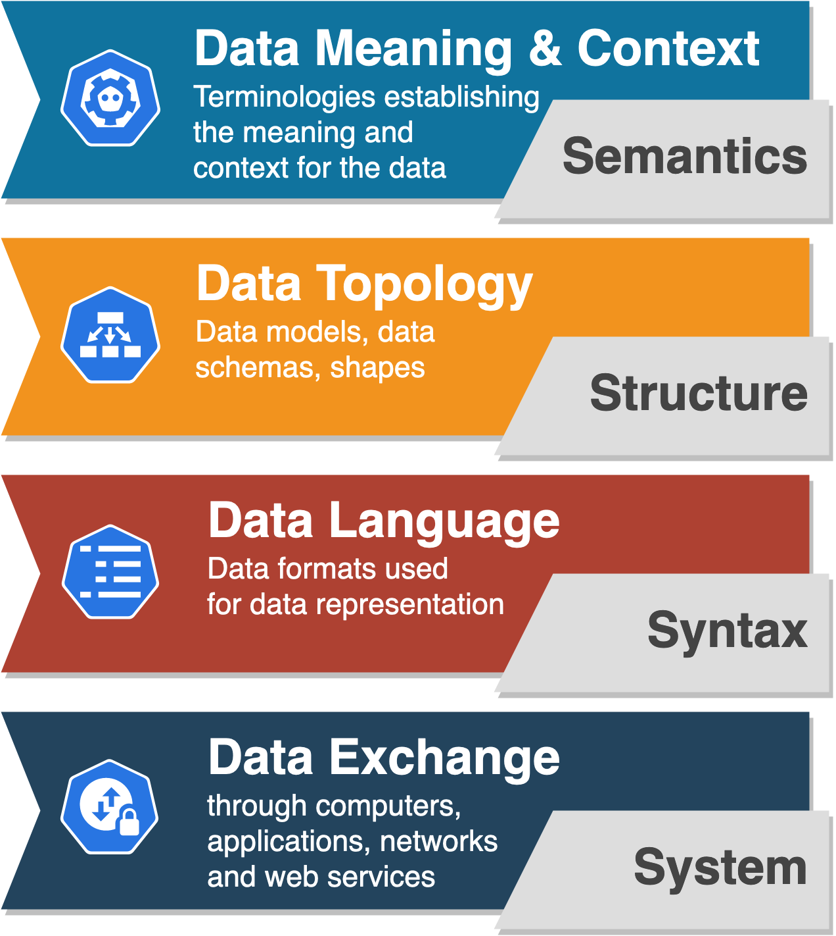
FAIR Guidelines: Interoperability
Common vocabularies
and mappings
WP2 & WP3 - work on vocabularies framework & ontologies
Common data schemas and validation processes
Use of NeXuS and its application definitions at facilities
Common data formats for different types of data and metadata
Use of HDF5 format and metadata catalogues
Common web services and Application Programming Interfaces (APIs) for data discovery, data access and data exchange
WP3 - implementation of common search API
Alejandra Gonzalez-Beltran

Slide 14
Bringing FAIR to the Experiment
Data Policy applies at the facilities level
This needs to be made happen for each experiment
For each experiment
Data/Metadata to be collected, data storage, connections to derived data, software used
Sounds like Hard Work!!!
Data Management Planning
DMP for an experiment needs to be done in context:
The DMP for its instrument and technique
The community norms for the discipline
The DMP of the user’s institution and funder
The DMP should be active
Help steer the collection of metadata in the experiment
Work with for example an Electronic Notebook
Facility Data Policy
Funder Data Policy
University Data Policy
Discipline Norms
Instrument DMP
User DMP
Experiment DMP

Slide 15
FAIR Experiment: Data Management Planning
Plan the many aspects of data and metadata generation, preservation, and analysis at the outset
Information on data and data format
Types of data generated, Volumes of data, File formats
Collection processes
Software used, Analysed data
Quality control
Metadata content and format
Metadata items collected.
Metadata standards
How collected?
Policies for access, sharing, and re-use
Obligations from funders
Specific ethical/privacy and IPR issues
Data Publication
Digital Object Identifiers
Long-term storage and data management
Where is the data going to land?
Especially derived data
Costs
Pros: can really assist in the allocation of resources and generation of reusable data
Expected data volumes Identify analysis routes and workflows Identify and fix bottlenecks ahead of time
Cons: Users may be agnostic or less convinced.
Extra work for proposal writing, Additional bureaucracy for access, Poor past experiences with DMPs
DMPs need careful consideration and presentation in the P&N community

Slide 16
Summary
P&N Facilities well-placed to assist their diverse user communities to produce FAIR data
However a lot of work required to cover the range of user communities and disciplines.
Guidelines for FAIR data and metadata implementation
Under preparation in both ExPaNDS and PaNOSC
Guidelines for PIDs and DMPs scheduled
Feeding into service development in the projects
Need to bring User Communities along

Slide 17
Thankyou
Brian Matthews
Brian.Matthews@stfc.ac.uk
https://expands.eu
Thanks to: Abigail McBirnie, Daniel Salvat, Alejandra Gonzalez-Beltran, Andy Gotz, Jonathan Taylor

